Slide 1
Professional skills for data science
Syntax bootcamp Ed Harris, Joseph Mhango

Slide 2
Setup & Intro
https://rstats-bootcamp.github.io/website

Slide 3
Objectives
How the module works
R motivation
Install R and RStudio or set up RStudio Cloud
RStudio components and setup
Workflow for scripts in R

Slide 4
How C7091 works
Lectures followed by problem sets for assessment
An introduction to statistics in R
Collaboration tools
Reproducible research and reporting stats

Slide 5
Why R
R is objectively the best statistical software available
R is designed for people with no programming experience to perform sophisticated statistical analysis with minimum effort
In wide use at universities, companies: job demand
Very large community of users
Free and open source
Works well on all computers and OSes, old and new

Slide 6
How to setup R and R studio
Install R and R Studio locally
Help for Windows
Help for Mac

Slide 7
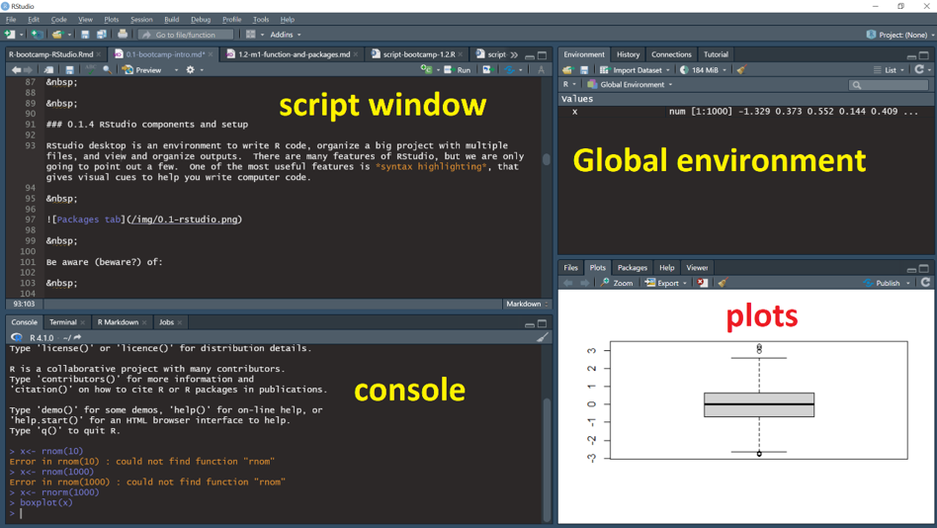
RStudio components and setup

Slide 8
R Language: General statement
R is a programming language designed to help non-programmers perform statistical analyses and to make graphs. This section is intended to guide people through some of the basics of the R programming language, just enough to get started.

Slide 9
The Life of Code…
R code can live comfortably in the following formats:
.R (Scripts)
.Rmd (R Markdown)
.Qmd (Quarto Markdown)
.ipynb (Jupyter Notebooks)

Slide 10
R projects and data can be saved in the following formats:
RStudio Project files, organizing scripts and data (.Rproj)
Workspace or multiple R objects (.RData)
Single R object (.Rds)

Slide 11
Things can get all woven up…
Example:
This presentation comes from a .Qmd document. It has a bunch of text called markdown, sprinkled around R code. The slides and images for the presentation are all organised neatly into an R project in a folder, with a .Rproj overlord
For the purposes of getting started with syntax, we will work strictly with a lone script

Slide 12
Writing R Scripts: Best Practices
Document Your Work: Scripts are a a record of your progress
Organise Your Code: Proper structure improves reproducibility
Write for Others: e.g. your future self or supervisor
Use Comments & Pseudocode: human readable with obvious flow

Slide 13
Important
Work through the instructions here in RStudio as you go along
Type you own code rather than using copy and paste
Document all the code in your own script and write clear, concise comments

Slide 14
The comment (#)…
The hashtag is used to declare comments
Anything that comes after a # on the same line is ignored by the R interpreter during execution
Don’t just litter everywhere (e.g. storing code as comments)

Slide 15
The comment (#)…
Comments are useful for:
+Making headers, tables of contents e.t.c. +Temporarily disabling undesired lines of code +Making code chunks
Example of a commenting convention:
Code chunks begin with 2 ## signs
Code chunks end with a consistent pattern

Slide 16
Header
Always have a header that introduces what the script is about, hopefully with a version number
## HEADER #### ## Who: <YOUR NAME> ## What: R syntax basics ## Last edited: <DATE TODAY in yyyy-mm-dd format> ## Version: 1.000 ####

Slide 17
Contents
## CONTENTS #### ## 1.1.1 Example script, help, pseudocode ## 1.1.2 Math operators ## 1.1.3 Logical Boolean operators ## 1.1.4 Regarding base R and the Tidyverse ## 1.1.5 Practice exercises

Slide 18
Outlines
Outlines enable you to jump around your script,
If you have clear delimiters in comments, RStudio recognises them as outlines
# ---- Loading libraries ---- library(stats) # ---- Iris scatter plots ---- plot(iris)

Slide 19
Getting Help in R

Slide 20
Community and Resources
R has a strong community with many websites, books, blogs, and more.
The vast array of resources can be overwhelming for beginners.
Best Practice: Start with the R Help System + Use the built-in R Help system first before exploring external resources

Slide 21
Accessing Built-in Help in R
The basic way to get help is by using the help() function.
Syntax: help(function_name)
Get help on the mean() function
# Display help page for the function mean help(mean)

Slide 22
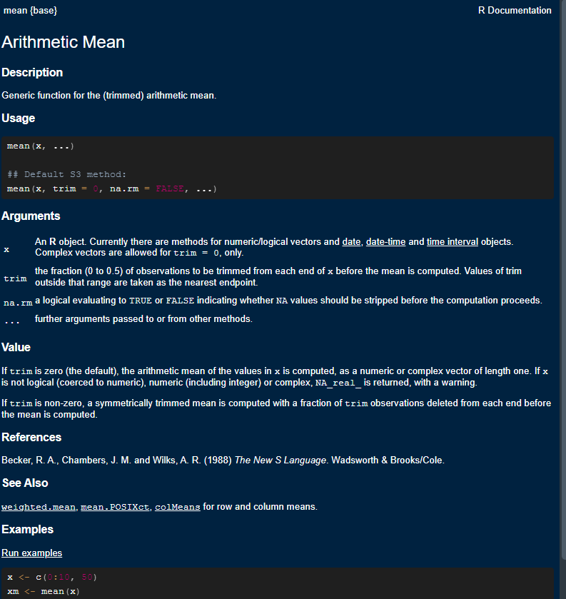

Slide 23
Help page format
Help pages have a consistent structure
1 Function name {Package name}: Tells you the package of the function
2 Short description: What the function does in brief.
3 (longer) description: What the function does
4 Usage: An example of the function in use and “arguments”
5 Argument definitions: What the argument are and what they do!
Value: What the function returns

Slide 24
Making Help work for us
Using the Usage and Argument fields, we can figure out how to make the function do the work we want.
Under Usage:
# Under Usage: # mean(x, ...) # The "x" is an argument that is required # The "..." means there are other optional arguments

Slide 25
Under Arguments:
# x # An R object... for numeric/logical vectors ...
Try this code in your own script
my_length <- c(101, 122, 97) # 3 numerical measures mean(x = my_length)

Slide 26
Pseudocode
Pseudocode is a way to break up a big task into a series of smaller tasks. For example:
Read data into R
Perform exploratory analysis
Perform statistical tests
Organize outputs to communicate in a report

Slide 27
Submitting code to the interpreter
Run whole line of code your cursor rests on Ctrl+Enter (Cmd+Return in Macs)
Run code you have selected Ctrl+Enter (Cmd+Return in Macs)
Use the “Run” menu above the Script window
Use the Code > Run dropdown menu

Slide 28
Now let’s put the interpreter to work…

Slide 29
Math operators
Basic manipulation of numbers in R is very easy and intuitive. Let’s try this non-exhaustive list:
Arithmetic
# Add with "+" 2 + 5 # Subtract with "-" 10 - 15 # Multiply with "*" and Divide by "/" (6 * 4.2)+(10 / 4)

Slide 30
More arithmetic
# raise to the power of x 2^3 2**3 9^(1/2) # same as sqrt()! 9**(1/2) # same as sqrt()! # There are a few others, but these are the basics

Slide 31
Order of operation
For complicated phrases like 2 + 2 * 8 - 6. the BODMAS/PEMDAS rule is followed unless unless a specific order is coded.
# Try this 4 + 2 * 3 # Order control - same 4 + (2 * 3) # Order control - different... (4 + 2) * 3

Slide 32
Use of spaces
# Try this 6+10 # no spaces 7 -5 # uneven spaces 1.6 / 2.3 # large spaces 16 * 3 # exactly 1 space # exactly 1 space is easiest to read...

Slide 33
Boolean operators
Boolean operators are expressions that resolve TRUE (treated as “1” in most computing systems including R) versus FALSE (“0”). A typical expression might be something like asking if 5 > 3, which is TRUE. More sophisticated phrases are possible, and sometimes useful.
3 > 5 # 3 is compared to each element 3 < c(1, 2, 3, 4, 5, 6)

Slide 34
Logic and math
& (ampersand) means “and”
(pipe) means “or”
#This asks if both phrases are true 3 > 1 & 1 < 5 3 < 1 | 1 < 5 3 < 1 | 1 > 5

Slide 35
Using Booleans
Booleans can be useful to select data
Put some data into a variable and then print the variable
Note <- is the ASSIGNMENT syntax in R, which puts the value on the left “into” x
The square brackets are there to allow us to specify an index of the data vector… more later
x <- c(21, 3, 5, 6, 22) x[x > 20]
[1] 21 22

Slide 36
The “not” operator - !
# Try this TRUE # plain true !FALSE # not false is true! 6 < 5 #definitely false !(6 < 5) #not false... !(c(23, 44, 16, 51, 12) > 50)

Slide 37
Base R and the Tidyverse

Slide 38
Base R
Base R: the basic functions which let R function as a language
library(help = "base")
Examples include functions like read.table(), data.frame(), etc.
Here’s the thing; mastering R is mastering Base R
Base R provides the tools you need to eventually even write your own R packages.

Slide 39
The Tidyverse
The Tidyverse is collection of R packages.
Developed by RStudio (Hadley Wickham and others), now called Posit.
Core packages: ggplot2, dplyr, tidyr, readr, tibble, and purrr.
Tidyverse focuses on:
Human-readable code.
Consistency across functions.
Easy-to-use tools for common data manipulation and visualization

Slide 40
Differences Between Base R and the Tidyverse
Base R provides lower-level intuitive functions; the Tidyverse provides simplified, higher-level abstractions.
Tidyverse emphasizes abstractions that make data wrangling easier
But guess what, most of the tidyverse is written on top of Base R
Base R is pretty stable, the tidyverse has a deprecation problem

Slide 41
The error traceback
Don’t be intimidated by the screaming red text
It’s all bark and no bite
if it looks confusing, use traceback() -Most of the times, it’s because:
you’re making calculations on an invalid datatype
you’re passing the wrong things to function arguments
you’ve made a syntax error somewhere

